Slide 1
SecureCheck: A Python-SQL Digital Ledger for Police Post Logs
Naveenkumar Sivakumar

Slide 2
Problem statement:
Methods to be used : Domain :
Police check posts require a centralized system for logging, tracking, and analyzing vehicle movements. Currently, manual logging and inefficient databases slow down security processes. This project aims to build an SQL-based check post database with a Python-powered dashboard for real-time insights and alerts.
Law Enforcement & Public Safety
Real-time Monitoring Systems
Python,
SQL,
Streamlit

Slide 3
Key Problems Addressed:
Eliminate Manual Logging (Paper/Spreadsheets).
Replace Inefficient Databases.
Target Output:
Real-time Insights on vehicle flow.
Automated Alerts for suspicious activity.

Slide 4
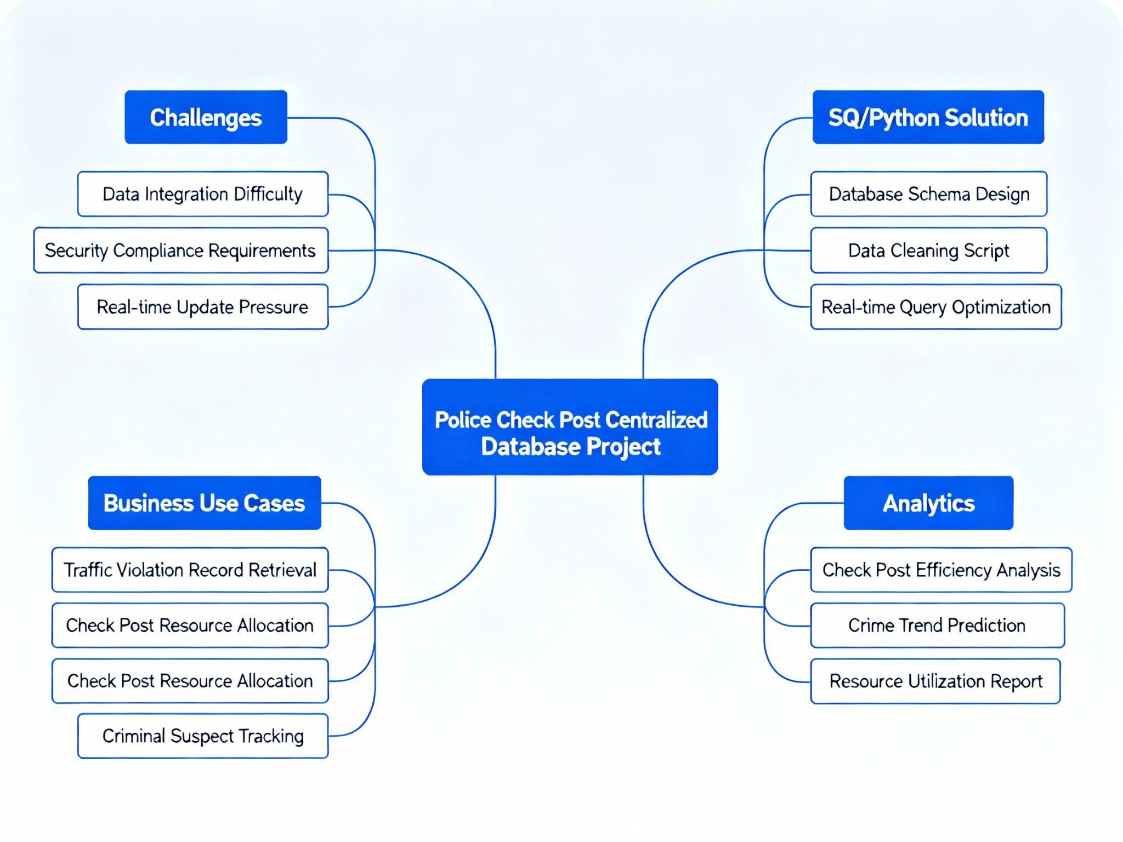

Slide 5
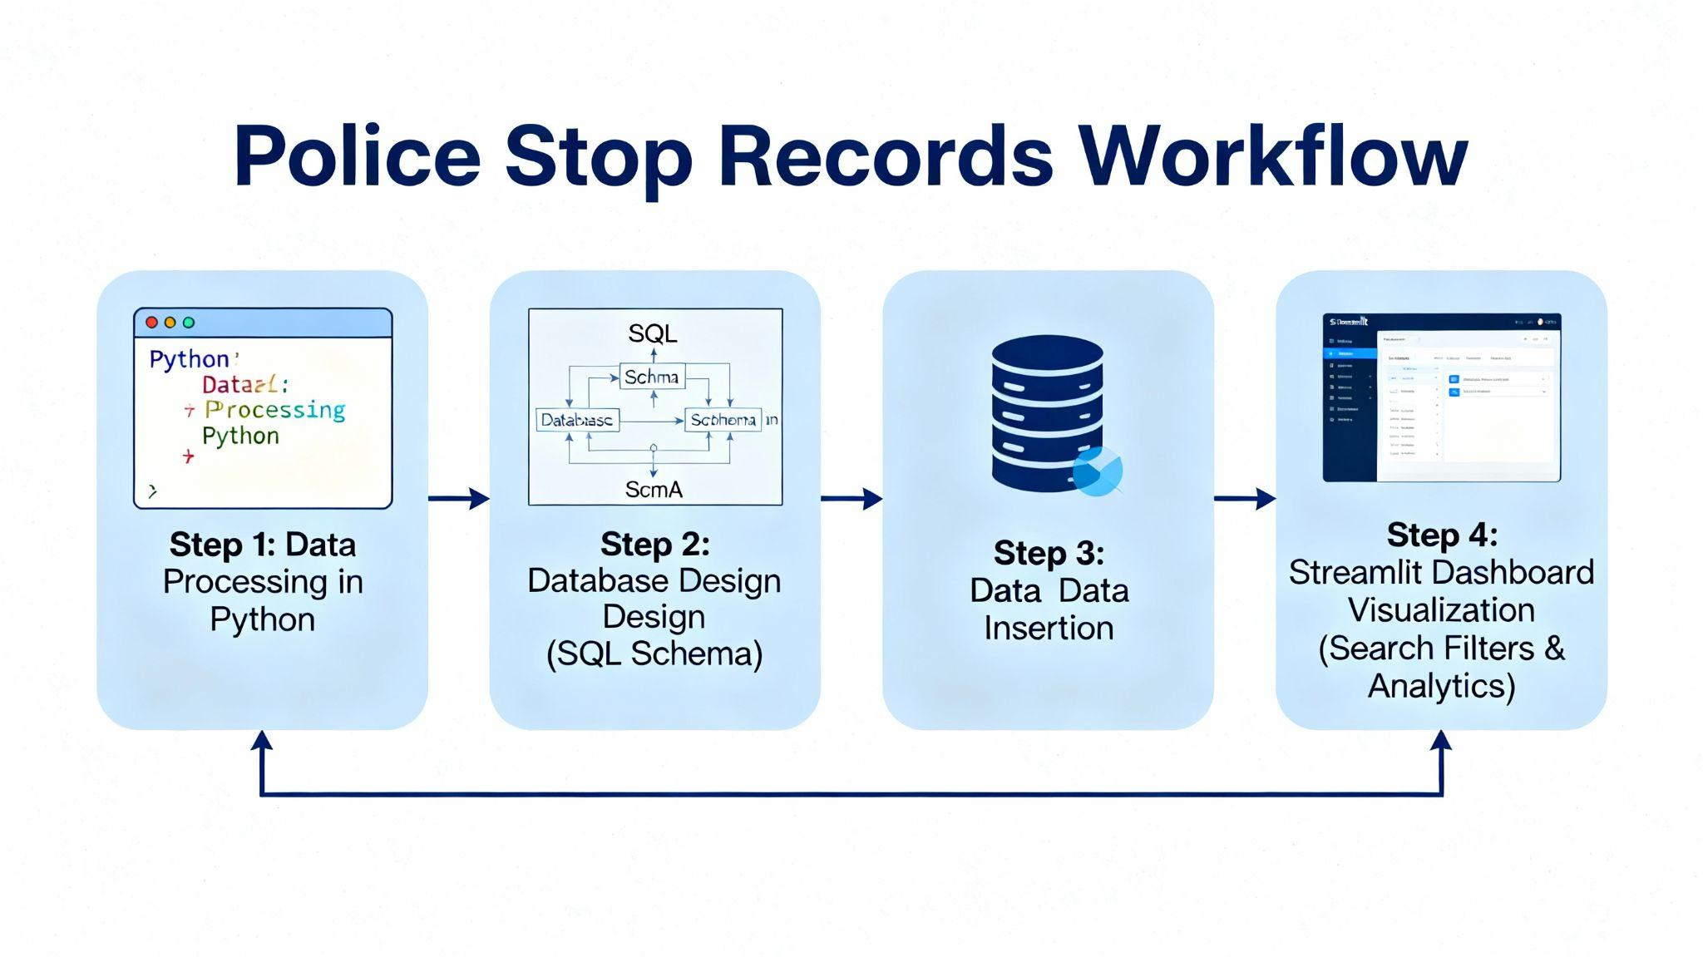

Slide 6
THANK YOU!!!

